Slide 1
LLM RAG Retrieval

Slide 2
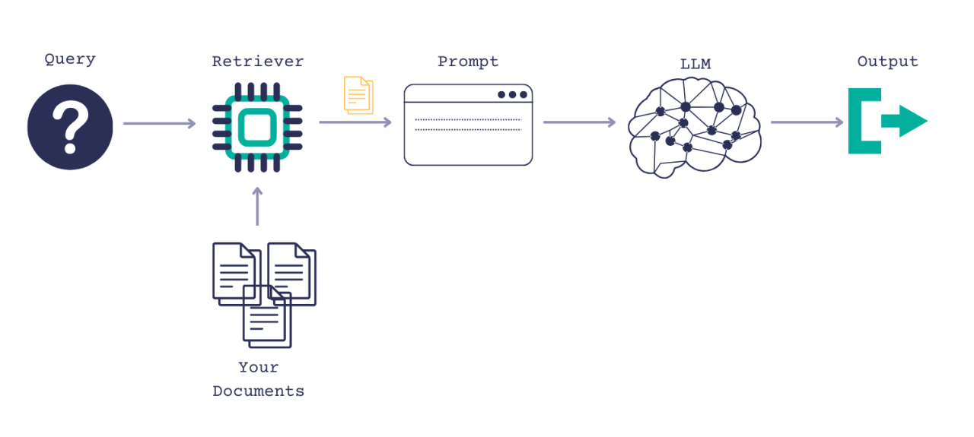
RAG Retrieval
Encoder model to search for similar documents when a given query.
Keyword Search
Semantic Search
Hybrid Search

Slide 3


Keyword Search BM25 Based on TF-IDF
TF_IDF Algorithm - Term Frequency & Inverse Document Frequency
TF - Measures how often a term t appears in a document d. indicates the term is more significant in the context of the document.
Inverse Document Frequency (IDF): how unique or rare a term is across the entire corpus D. If a term appears in many documents, its IDF is low, as it's less discriminative.
TF-IDF(t,d,D)=TF(t,d)×IDF(t,D)

Slide 4
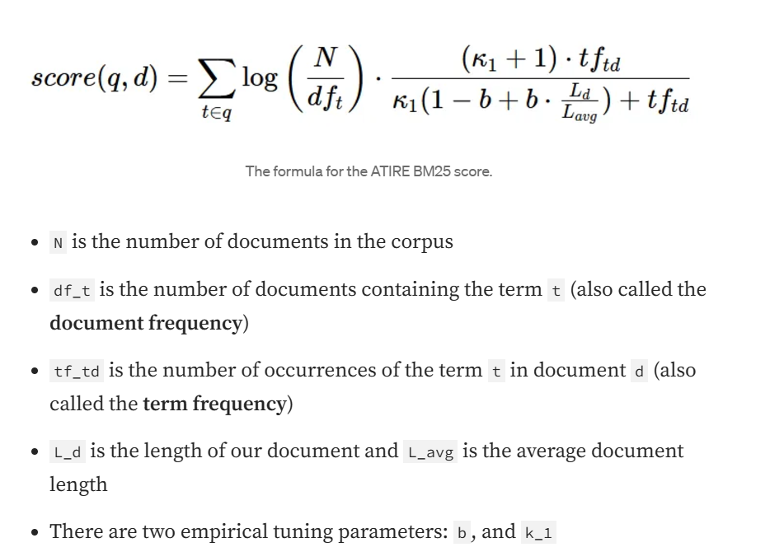
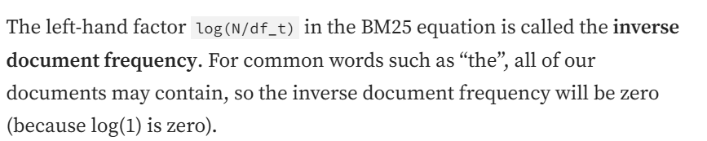
Langchain uses BM25Okapi

Slide 5
Limitation of TF-IDF
Non - Linear Term Saturation:
Increases linearly with the count of term in document.
Term appears many times, it disproportionately boosts the document relevance score even when additional occurrences provide diminishing informational value
K - Control term saturation, diminish frequently occurring term 1.2 to 2.0
Document Length Normalization
Longer document might be unfairly favored based on the toral term count. Parameter term b (~ 0.75) Normalizes TF based on document length
Handling Rare & Common word

Slide 6
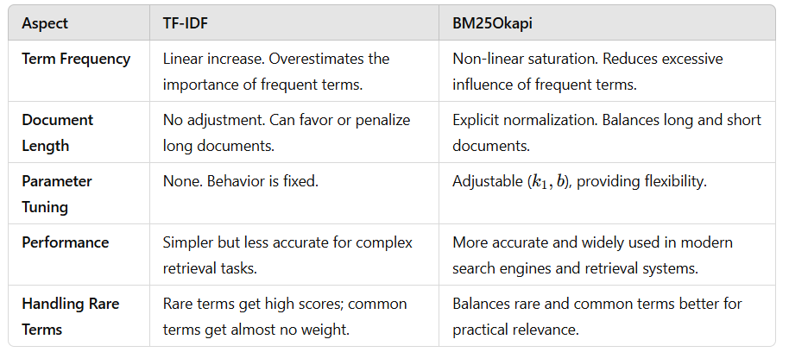
Practical Comparison

Slide 7
Let's check the code

Slide 8
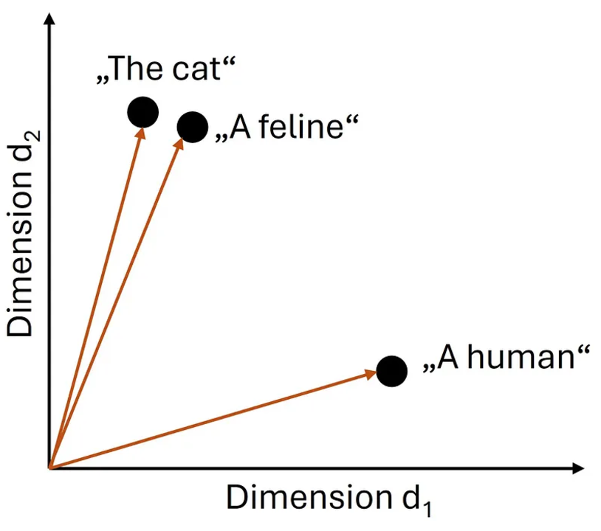
Semantic Search Dense Embedding

Slide 9
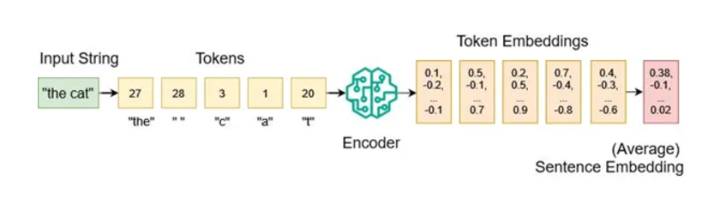
Text Embedding
High Dimensional Vectors
Dense Vectors (each entry is meaningful numbers) / Sparse - Zero

Slide 10
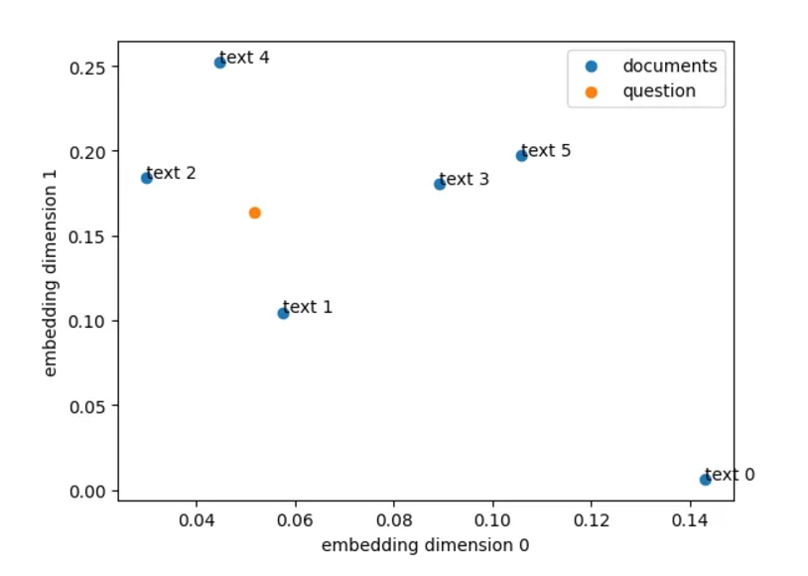
Scatter Plot of Sentence embedding

Slide 11
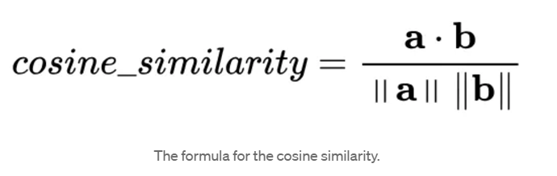
Similarity - Cosine Similarity
Range is between -1 to +1
+1 —> Same
0 —-> Unrelated
-1 —> Exactly in Opposite direction

Slide 12
Let's Check Code

Slide 13
Semantic or Keyword
Keyword search with BM25 looks for exact matches of the query term.
Semantic search, on the other hand, looks for semantically similar content.

Slide 14
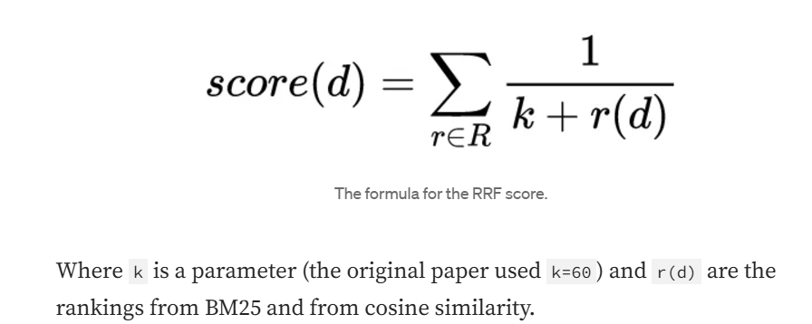
Hybrid Search
Reciprocal Rank Fusion (RRF). RRF is a simple algorithm for combining the rankings of different scoring functions . The idea behind RRF is to give higher weight to items that are ranked higher in any of the individual ranked lists.
Use constant K avoid over-penalizing items ranked lower in the lists.

Slide 15
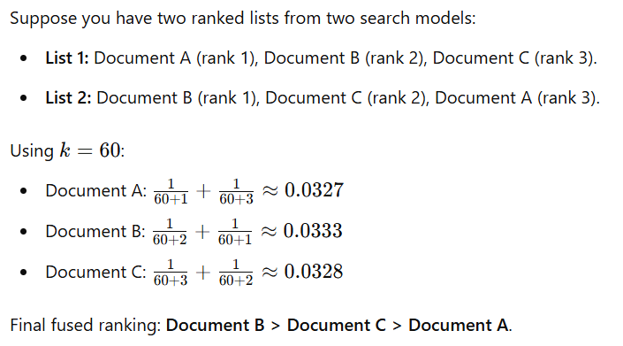
Example: RRF

Slide 16
Let's Check Code

Slide 17
Reference
https://towardsdatascience.com/how-to-use-hybrid-search-for-better-llm-rag-retrieval-032f66810ebe
Dr. Leon Eversberg

